Slide 1
Week 1: Reporting and Disclosure-Introduction
Prof. Zheng Wang
AC8900
Semester A 2026/2027

Slide 2
Types of Accounting Research
 | AIS | Audit | Financial | Managerial | Tax | Other Topic
Analytical | AIS Analytic | Audit Analytic | Financial Analytic | Managerial Analytic | Tax Analytic | Other Analytic
Archival | AIS Archival | Audit Archival | Financial Archival | Managerial Archival | Tax Archival | Other Archival
Experimental | AIS Experimental | Audit Experimental | Financial Experimental | Managerial Experimental | Tax Experimental | Other Experimental
Other Method | AIS Other | Audit Other | Financial Other | Managerial Other | Tax Other | Other Topic Other Method
Source: byuaccounting.net

Slide 3
Major Journals Publishing Accounting Research
Major Accounting Journals: TAR, JAR, JAE, CAR, RAST
Other Accounting Journals: AOS, AJPT, JATA, JMAR, JAAF, JAPP, JBFA, AH
Major Finance Journals: JF, JFE, RFS, JFQA
Other Finance Journals: ROF, JBF, JCF, JEF, FM
Other Journals: FT 45 Journals http://www.ft.com/cms/s/2/3405a512-5cbb-11e1-8f1f-00144feabdc0.html#axzz3dJ8ZZM1h
Notes:
First, ex-ante, firms’ managers typically have more information about the expected profitability of firms’ current and future investments than outsiders. This problem is exacerbated because insiders (both managers and owner-managers) have incentives to exaggerate their firms’ projected profitability. This ‘‘lemons problem’’ (Akerlof, 1970).
By fulfilling both demands, investors require a lower rate of return ex-ante when they can rely on such information.

Slide 4
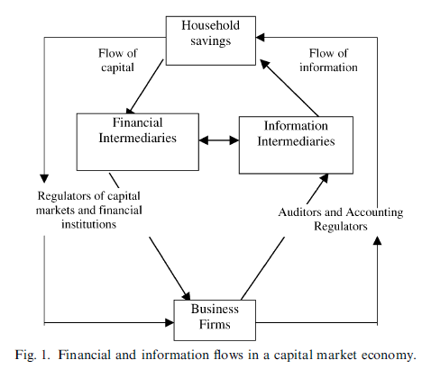
Information and Capital Market
Source: Healy and Palepu, JAE2001

Slide 5
Two Agency Problems that Give Rise to the Demand for Information
Adverse Selection:
  The information asymmetry between firms’ insiders (managers or existing owners) and outside capital providers makes it difficult for outside capital providers to assess the profitability of the firm’s investment opportunities. If capital providers cannot assess firms’ profitability, they will under- price firms with high profitability and over-price firms with low profitability, potentially leading to market failure.
Moral Hazard:
  Due to the separation of ownership and control, capital providers do not have full decision-making rights. To solve this agency problem, both implicit and explicit contracts often use accounting information such as the use of resources, decisions taken, and generated return on investments. Investors value such information ex-post for monitoring managerial behavior.
Notes:
First, ex-ante, firms’ managers typically have more information about the expected profitability of firms’ current and future investments than outsiders. This problem is exacerbated because insiders (both managers and owner-managers) have incentives to exaggerate their firms’ projected profitability. This ‘‘lemons problem’’ (Akerlof, 1970).
By fulfilling both demands, investors require a lower rate of return ex-ante when they can rely on such information.

Slide 6
The Roles of Accounting Information
Valuation role: control adverse selection
  allows capital providers (shareholders and creditors) to evaluate the return potential of investment opportunities.
  Ex ante information demand
Stewardship role: control moral hazard
  allows capital providers to monitor managerial behavior after their capital is committed.
  Ex-post information demand.
Both roles are crucial, but may not overlap completely.

Slide 7
Unraveling Result (Grossman and Hart 1980; Grossman 1981; Milgrom 1981; Milgrom and Roberts 1986)
Managers will voluntarily disclose all of their private information if:
disclosures are costless;
investors know that ﬁrms have, in fact, private information;
all investors interpret the ﬁrms’ disclosure in the same way and ﬁrms know how investors will interpret that disclosure;
managers want to maximize their ﬁrms’ share prices;
ﬁrms can credibly disclose their private information;
ﬁrms cannot commit ex-ante to a speciﬁc disclosure policy.

Slide 8
Different Information Sources
Mandatory Reporting
  e.g., 10-K and 8-K filings, earnings announcements
Voluntary corporate disclosure
  Usually forward looking, e.g., management forecasts, conference calls, discretionary news release
3. Third party: information intermediary
  Analyst forecasts, short-selling reports

Slide 9
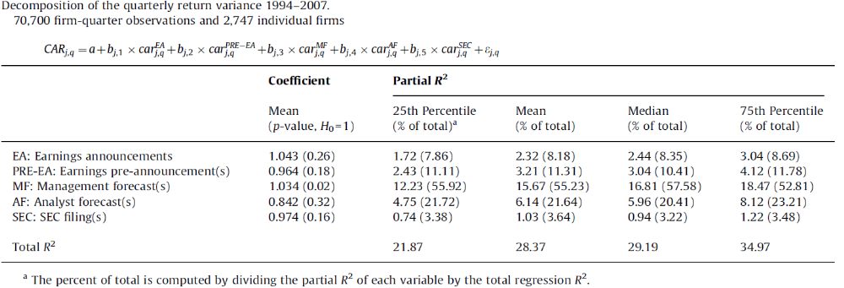
Beyer, Cohen, Lys, and Walther (2010): JAE

Slide 10
“Broad” Research Questions in Reportingand Disclosure
1. Evaluate the decision usefulness of financial reporting and disclosure to capital providers.
2. Manager’s accounting and disclosure choices
  Determinants and consequences of earnings management and voluntary disclosures

Slide 11
Mandatory Reporting

Slide 12
Topics Related to Mandatory Reporting
Usefulness of Earnings for decision making
Earnings Management
Earnings Quality
Conservatism
Mandatory reporting requirement changes: e.g., risk factor disclosure, segment reporting, IFRS adoption

Slide 13
Decision usefulness (Efficient market approach)
Assumes securities market efficiency
Investors predict future firm performance to price firms’ securities
  Role of financial reporting to provide useful information for this purpose
Usefulness of financial information evaluated by magnitude of security price response to that information

Slide 14
Reasons for Security Price Response
  Investors have prior expectations on future firm performance
  Investors obtain useful information from financial statements
  Investors revise their expectations
  Leads to buy/sell decisions
  Security price changes
  Return on share changes

Slide 15
Abnormal Share Return
Total share return = return due to market-wide factors ± abnormal share return due to firm-specific factors
  Only abnormal share return can be attributed to financial accounting information
  If good news in financial statements leads to positive abnormal share return (and vice versa), conclude financial statement information is useful.
  To reach such a conclusion, need to separate market-wide and firm-specific returns

Slide 16
Separating Market-Wide and Firm-Specific Factors
Firm releases financial information
  Most studies look at release of earnings
Use market model to estimate market-wide return on that day (or narrow window)
  Assumes market efficiency
Abnormal share return during narrow window = total return – market-wide return

Slide 17
Unexpected Earnings
Investors have expectations of the to-be-announced earnings
Investors’ expectations are built into share price prior to release of current earnings
  Assumes market efficiency
Investors will react only to unexpected earnings
Investors’ earnings expectations unobservable
  How to separate expected and unexpected earnings?

Slide 18
Estimation of Investors’ Earnings Expectations
Time series approach
  Based on earnings in prior years
Analysts’ forecasts
  Available for most large firms
  Now the most common approach

Slide 19
The Ball and Brown (1968) Study
The First Study to Document Statistically a Share Price Response to Reported Net Income (1968)
Methodology Still in Use Today

Slide 20
B&B Methodology
For Each Sample Firm:
  Estimate investors’ earnings expectations (Expected earnings based on regression model and last year’s earnings)
  Classify each firm as having GN (actual earnings > expected earnings) or BN (vice versa)
  Estimate abnormal share return for month of release of earnings (month 0)

Slide 21
B&B Methodology
Calculate Average Abnormal Share Return for GN Firms for Month 0
Ditto for BN Firms
Repeat for Months -1, -2,…,-11, and Months +1, +2,…,+6
Plot Results

Slide 22
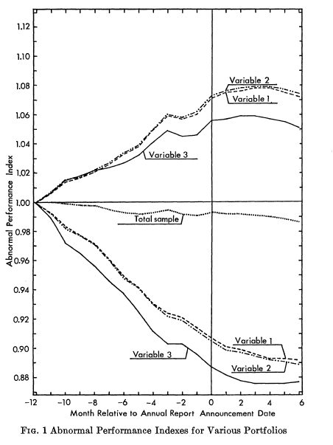
B&B Results

Slide 23
B&B Conclusion
Stock Market Reacts to Accounting Information, but Begins to Anticipate the GN or BN in Earnings 12 Months Prior to Month of Earnings Announcement
  Consistent with securities market efficiency and underlying rational decision theory

Slide 24
Earnings Management

Slide 25
What is Earnings Management?
Earnings management is the choice by a manager of accounting policies, or real actions that affect earnings, so as to achieve some specific reported earnings objective

Slide 26
What is Earnings Management?
26
Schipper (1989, 92): "...a purposeful intervention in the external financial reporting process, with the intent of obtaining some private gain (as opposed to, say, merely facilitating the neutral operation of the process)....“
Healy and Wahlen (1999, 368): "Earnings management occurs when managers use judgment in financial reporting and in structuring transactions to alter financial reports to either mislead some stakeholders about the underlying economic performance of the company, or to influence contractual outcomes that depend on reported accounting numbers"

Slide 27
Patterns of Earnings Management
Big Bath
Income minimization
Income maximization
Income smooth

Slide 28
Methods of Earnings Management
Accrual vs. real manipulation
GAAP-consistent vs. GAAP-violating manipulation (restatements, SEC investigations)

Slide 29
Managing Reported Earnings Through Discretionary Accruals
NI = OCF ± net accruals
  = OCF ± net non-discretionary accruals ± net discretionary accruals
Examples of discretionary accruals
  Allowance for doubtful accounts
  Warranty provisions
  Provisions for reorganization, layoffs, restructuring
  Contract completion costs
Note that discretionary accruals not directly observable by investors

Slide 30
Real Manipulations
Sales manipulation, that is, accelerating the timing of sales and/or generating additional unsustainable sales through increased price discounts, more lenient credit terms, announcement of price increase in future period, etc… ;
Reduction of discretionary expenditures (R&D, advertising, maintenance, etc…);
Overproduction, or increasing production to report lower COGS;
Timing of assets disposals.

Slide 31
Measurements
Accrual magnitudes
Abnormal accruals
Earnings distributions (benchmark beating)
Restatements, AAERs
Earnings smoothing

Slide 32
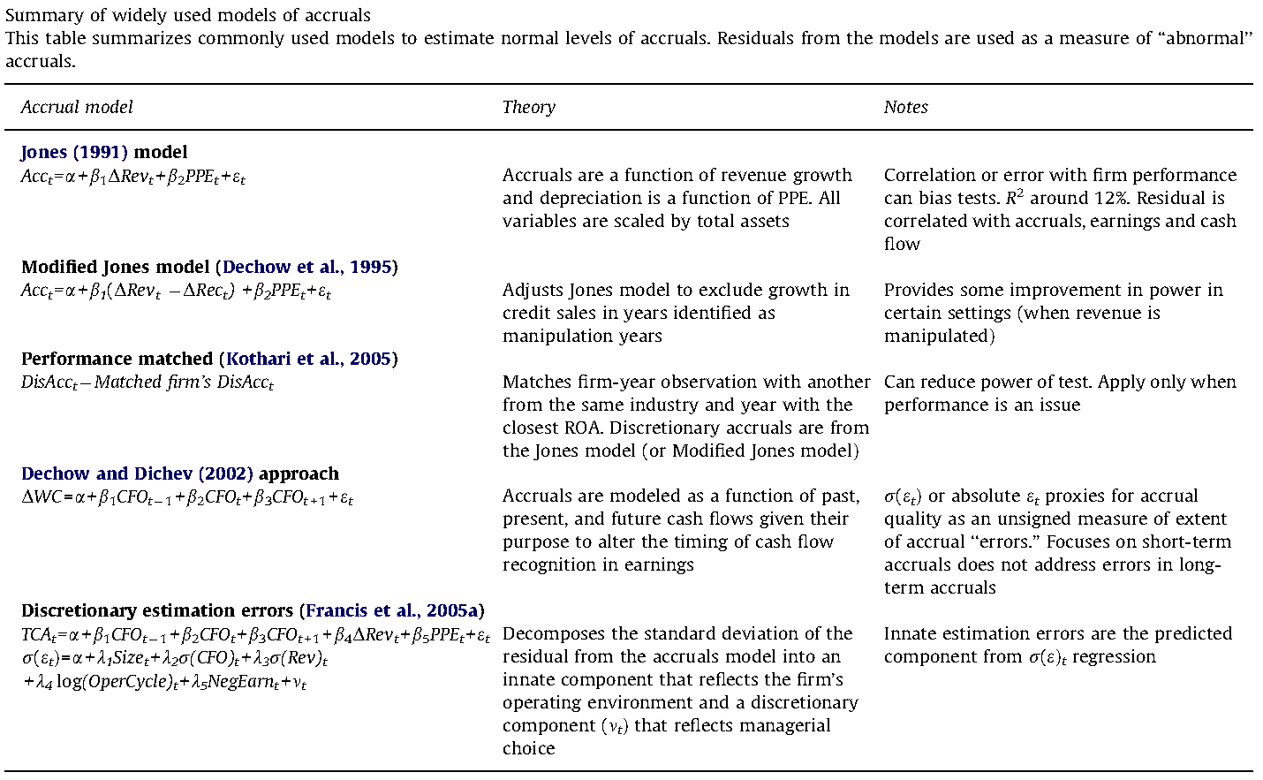
From: Dechow et al. 2010

Slide 33
Accounting Conservatism

Slide 34
Conservatism Defined
The accountant’s tendency to require a higher degree of verification to recognize good news as gains than to recognize bad news as losses.
E.g. lower of cost or market rules for inventory, impairment accounting rules
“Conditional” vs. “unconditional” conservatism

Slide 35
Role of Conservatism
Limit managerial incentives and ability to overstate financial performance.
Accounting numbers are more reliable and less suspect of manipulation

Slide 36
Conservatism measurement
The empirical outcome of conservatism: earnings should be more timely in reflecting bad news than good news—asymmetric timeliness

Slide 37
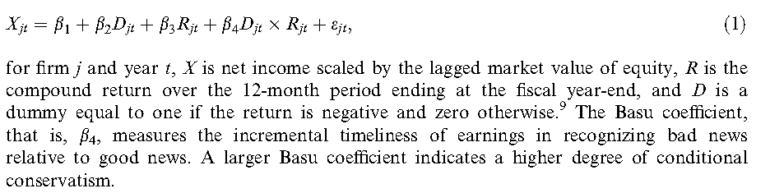
Key measure: The Basu coefficient (Basu 1997)

Slide 38
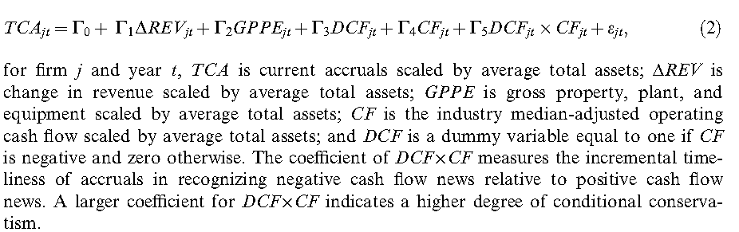
A non-price based measure

Slide 39
The firm-year measure of Khan and Watts (2009)
It is based on the Basu measure
Using a deterministic model, it converts the Basu coefficient to firm-year level;

Slide 40
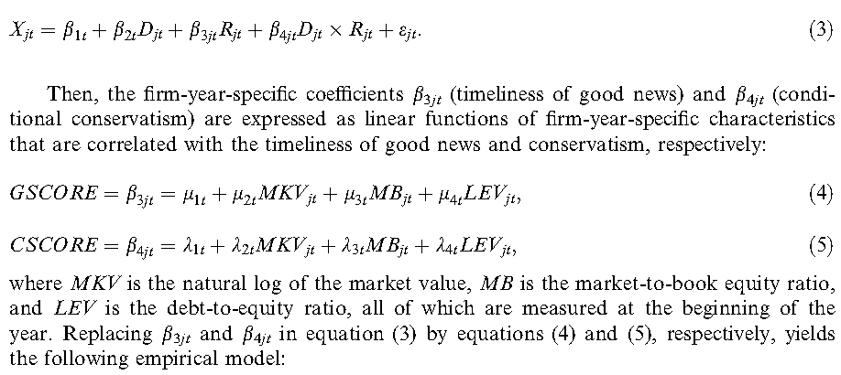
Details: Khan & Watts
Re-write the Basu model, then express the coefficients by the determinants of
conservatism:

Slide 41
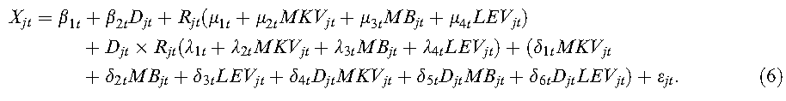
Details: Khan & Watts (cont.)
For (6), run annual regressions using all firm’s observations and estimate the
Coefficients in (6), which are then used as parameters in (5) to calculate CSCORE for
each firm.

Slide 42
Other measures
Non-operating accruals;
Book-to-market ratio and its variants;
Negative skewness of earnings.

Slide 43
Interpretations for conservatism
Debt contract: low bound numbers
Compensation contract
Governance: timely termination of negative NPV projects
Auditor litigation risk
Taxation

Slide 44
Voluntary Disclosure

Slide 45
(Dis)incentives for Voluntary Disclosure
Capital Providers’ information demand: Managers carter to such demand for capital market benefits:
Better liquidity, lower cost of capital, and improved firm value
  IPO, SEOs, debt issuance
Stock-based compensation and corporate control contest
Career concern
Litigation
Proprietary cost
Other determinants: managerial style, managerial ability
Notes:
Research suggests that there is significant demand from capital market participants for the disclosure of earnings forecasts by managers (see Healy and Palepu [2001], Core [2001], Hirst, Koonce, and Venkataraman [2008], and Leuz and Wysocki [2008] for reviews). This same research suggests that managers decide whether to issue forecasts based on their perceptions of the costs and benefits to the firm (e.g., higher liquidity and lower capital costs are weighed against proprietary and litigation costs) and to themselves (e.g., effects on reputation and stock compensation). Managers are more likely to issue forecasts when they expect growth (Core [2001]) or rising earnings (Miller [2002]), and have the ability to accurately predict earn- ings and meet or beat their forecasts (Hutton and Stocken [2009], Bhojraj, Libby, and Yang [2011]). Firms tend to cease issuing forecasts in the face of a sequence of bad quarters or when their forecast accuracy declines (Chen, Matsumoto, and Rajgopal [2011], Houston, Lev, and Tucker [2010]).

Slide 46
Different Forms of Voluntary Disclosure
Management forecasts
Conference calls
Nongaap earnings
Textual content
Discretionary news release

Slide 47
Homework: Why is voluntary disclosure not cheap talk?

